Slide 1
TU856-1 and TU858-1 Computer Architecture and Technology
Thursday 13 February 2025
(Week 3) Tutorial 1

Slide 2
Questions and Answers ( 1 )
Why are Computer Systems Powered by Electricity?
A great number of mechanical devices in industry of the Western World were being designed with electrical power as they were cleaner and more reliable than steam or oil-fired machines.
With analog number machines the cogs, wheels and dials could be calibrated to electrical motors such as servo-motors.
Binary machines suited electrical switches (EG relays).

Slide 3
Questions and Answers ( 2 )
Binary and Electricity?
YES! If you think about it: electricity has two main states – there or not there – and binary has two too! (1 or 0).
As mentioned in the lecture on Monday, atoms have electrons, and flow of these electrons is defined as electricity.
When a computer is working, many components - especially the CPU - have electrons zipping through, going on and off as ones and zeros.

Slide 4
Questions and Answers ( 3 )
What is CMOS and Why?
CMOS – Complementary Metal Oxide Semiconductor
CMOS can be related to architecture, and is used in microprocessors, microcontrollers, static RAM, and other digital logic circuits.
This design is energy efficient. Compared to Transistor-Transistor Logic, for example, it does not have lots of current to generate excessive heat.
A lot of logic functions can be crammed onto a CMOS chip.
https://www.youtube.com/watch?v=J8ZPIDNaijs (CMOS on Youtube)

Slide 5
Questions and Answers ( 4 )
What is FET again?
FET = “Metal Oxide Semiconductor Field Effect Transistors”.
A FET is a device which enables us to use one electrical signal to control another. The name 'transistor' is a shortened version of the original term, transfer resistor, which indicates how the device works.

Slide 6
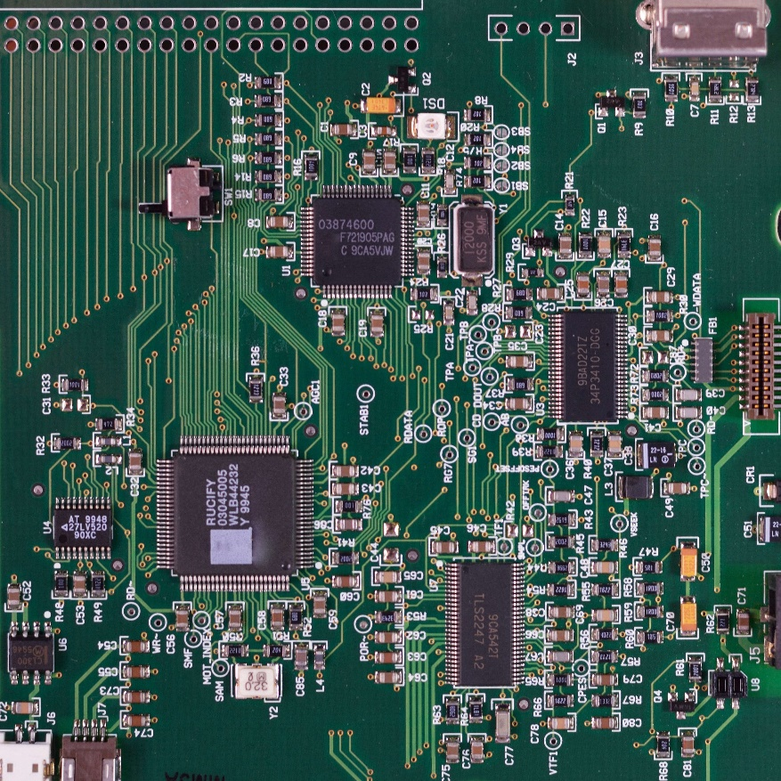

DIGITAL ELECTRICITY
Paths;
Long paths
Short paths
Thick paths
Thin paths

Slide 7
FET Extras
The source and drain diffusion areas of an nFET are implanted with negatively charged particles. When an nFET is used in a logic circuit its source lead is connected to GND, so that the nFET source, like the GND node, has an abundance of negatively charged particles.
If the gate voltage of an nFET is at the same voltage as the source lead (I.E., GND), then the presence of the negatively charged particles on the gate repels negatively charged particles from the channel region immediately under the gate. A net positive charge accumulates under the gate, and two back-to-back positive-negative junctions of charge (called pn junctions) are formed. These pn junctions prevent current flow in either direction.

Slide 8
Typical Exam (Sub) Question For This Content
Question
Describe the physical effects of conductivity that allows electrical energy to flow through a conductor such as a metal. Show how this relates to the concept of the electronic circuit.
Sample solution
Electricity starts with electrons. Every atom contains one or more electrons. Electrons have a negative charge. Some materials contain electrons which stick with their atoms. Because the electrons do not move these materials cannot conduct electricity very well, if at all. These materials may act as electrical insulators.
While elements and compounds of various densities will insulate electricity most metals have electrons that can detach from their atoms and move around. These are called free electrons. Gold, silver, copper, aluminum, iron, etcetera all have free electrons. The loose electrons make it easy for electricity to flow through these materials, so they are known as electrical conductors. They conduct electricity. The moving electrons transmit electrical energy from one point to another.

Slide 9
Solution continued
In an electrical circuit the number of electrons that are moving is called the amperage or the current. Current is measured in amps. (Short for the proper term, ‘ampere’.) In terms of movement, one amp is equal to one ‘coulomb’ per second.
The ‘pressure’ pushing the electrons along is called the voltage and is measured in volts.
Voltage example:
1 amp at 6 volts.
1 amp physically means that 6.24 x 1018 electrons move through a wire every second),
One amp is the number of electrons moving and the voltage is the amount of pressure behind those electrons.

Slide 10
Solution continued
The electrons will need to flow from the negative terminal to the positive terminal through a wire or some other conductor. When there is a path that goes from the negative to the positive terminal, you have a circuit, and electrons can flow through the wire. Electrical circuits can get quite complex. But at the simplest level, you always have the source of electricity (a battery, etc.), a load (a light bulb, motor, etc.), and two wires to carry electricity between the battery and the load. Electrons move from the source, through the load and back to the source.
(10 marks)

